Slide 1
XRISM overview / Hitomi highlights
Richard Kelley
NASA Goddard Space Flight Center
The 1st XRISM Data Analysis Workshop
University of Maryland
February 22-23, 2023
Chandra image
Hitomi/SXS spectrum

Slide 2
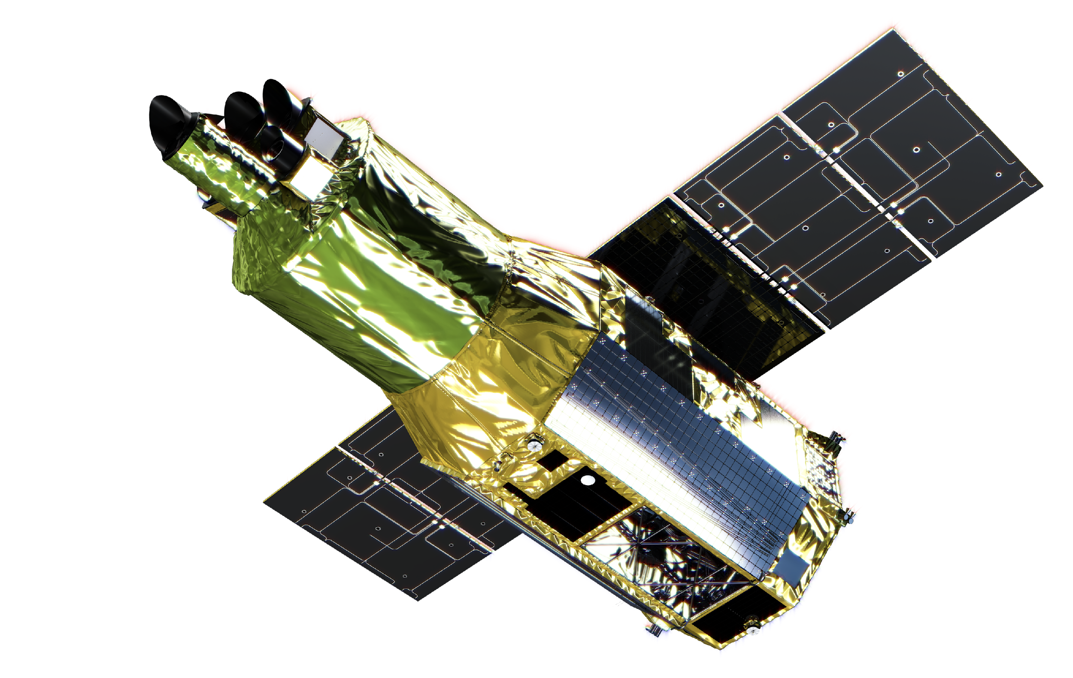
Overview
JAXA/NASA collaborative mission with ESA participation
Two Instruments with focusing x-ray optics:
Resolve – non-dispersive, high-resolution x-ray spectrometer (0.3-12 keV). Nominal 3-year cryogen lifetime ; extended cryogen-free mode thereafter.
Xtend – CCD x-ray camera with 38’ field of view
Launch anticipated for mid-2023
Mission goals are to pick up where the Hitomi mission prematurely left off.
Following a 9-month commissioning and performance verification phase, a general guest observer phase will begin.

Slide 3
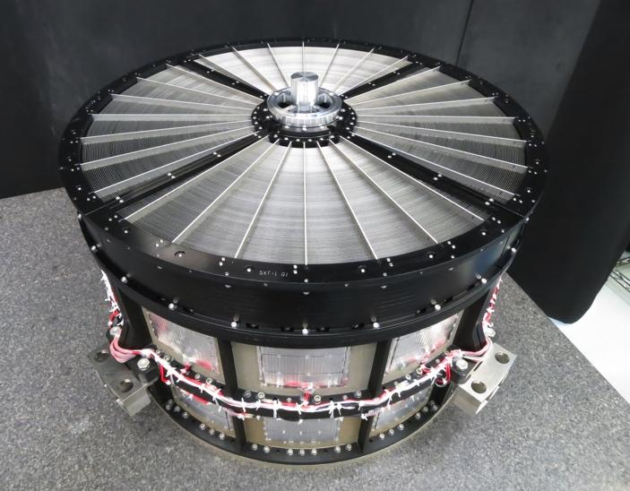
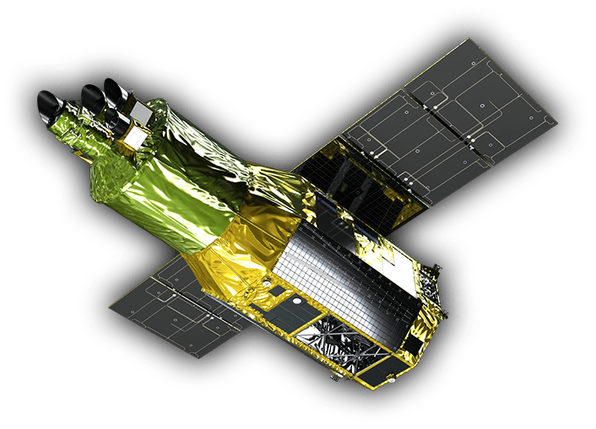
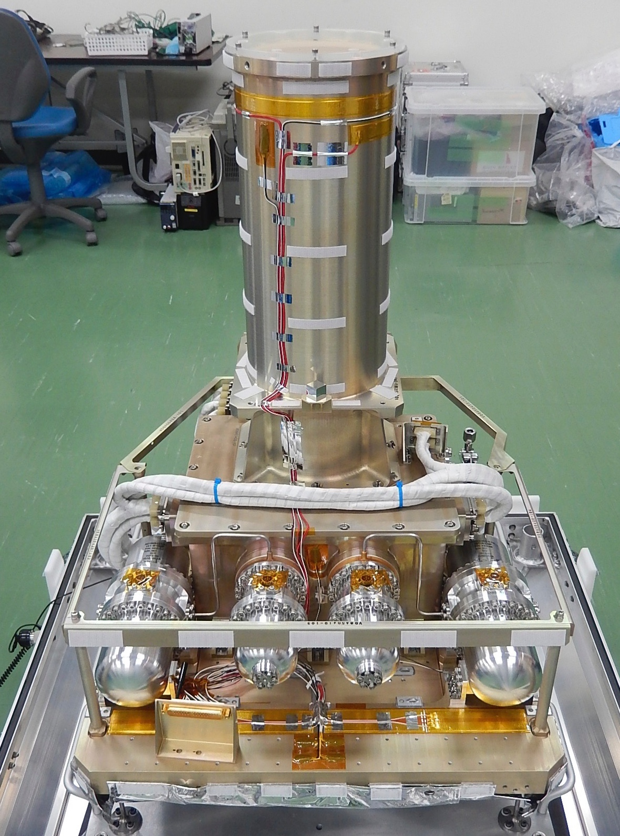
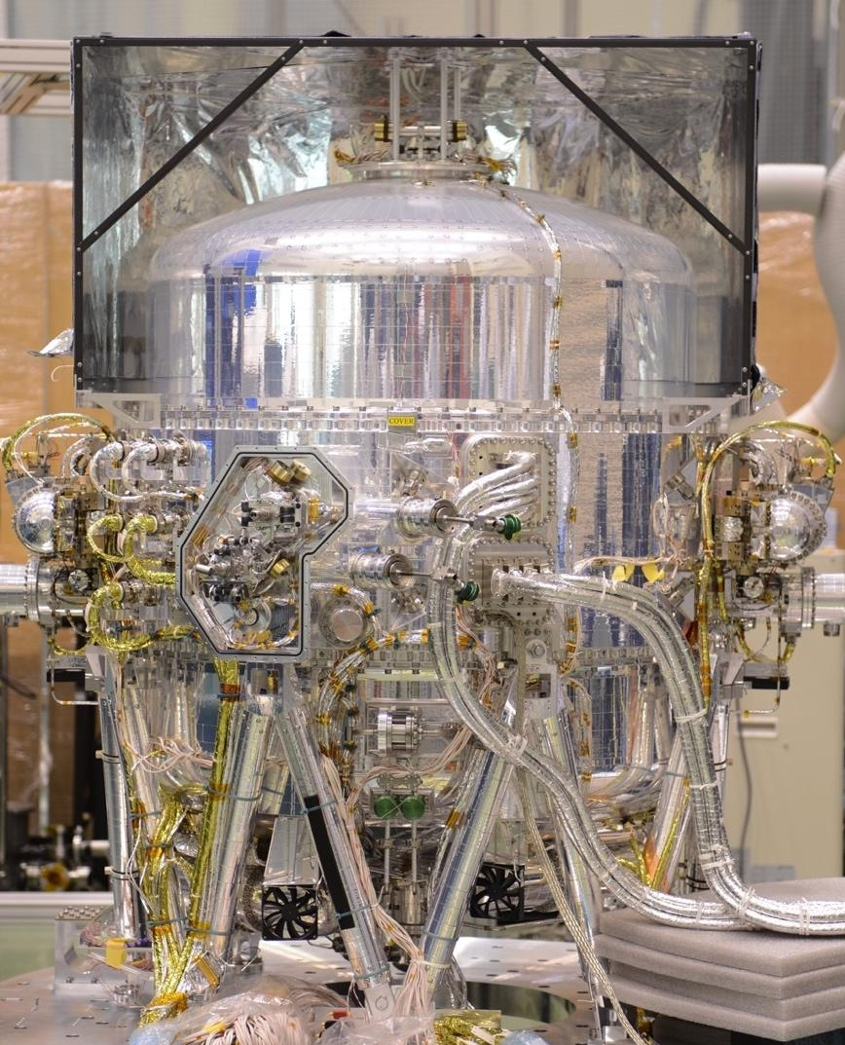
The X-Ray Imaging and Spectroscopy Mission
X-Ray Mirror Assemblies (x2)
Resolve X-Ray Spectrometer
Xtend CCD Imager

Slide 4
“Xtend” Imaging Camera
Large FOV, highly-sensitive X-ray CCD camera
The largest FOV of 38′×38′ among focal-plane X-ray CCD cameras flown to space so far, complementary to Resolve
Back-illuminated P-ch CCDs with a depletion layer thickness of 200 μm, high detection efficiency in 0.4-13 keV
~ 190 eV energy resolution (FWHM) at 6 keV.

Slide 5
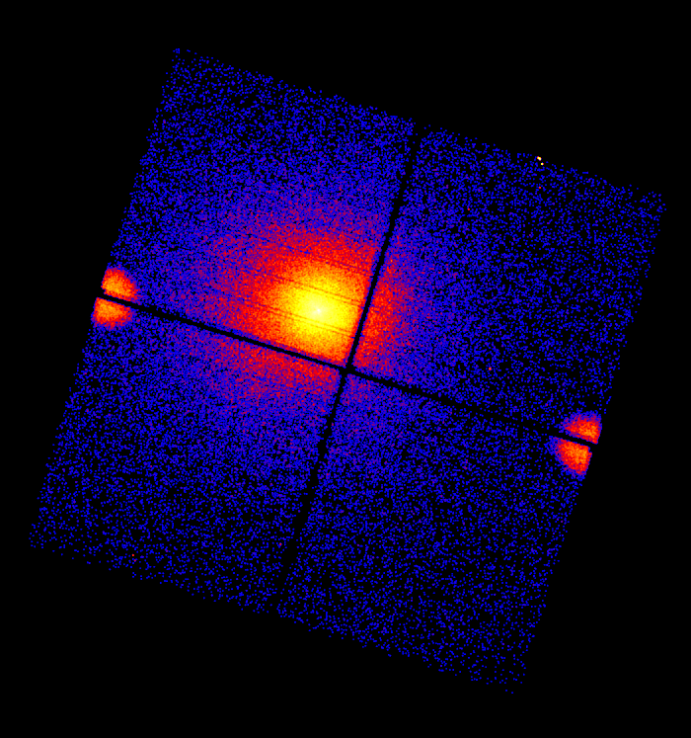
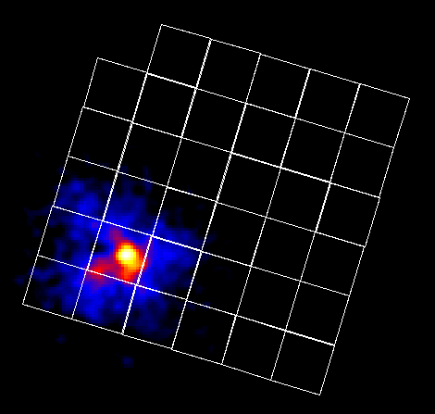
X-ray image from Hitomi SXI
2 x 2 mosaic using 4 chips = 38′ × 38′
complementary to Resolve
Finer pixel size
1.74” in Xtend vs 30” in Resolve
38 arcmin
The Perseus cluster
⁵⁵Fe
⁵⁵Fe
SXI image
SXS image

Slide 6
Resolve Top-level Performance Requirements
Parameter | Requirement | Expected
Energy resolution | 7 eV (FWHM) | 5.0 eV ✓
Energy scale accuracy | ± 2 eV | ± 0.5 eV ✓
Residual Background | 2 x 10⁻³ counts/s/keV | 0.8 x 10⁻³ counts/s/keV*
Field of view | 2.9 x 2.9 arcmin | same, by design
Angular resolution | 1.7 arcmin (HPD) | 1.3 arcmin
Effective area (1 keV) | > 160 cm² | 241 cm² ✓
Effective area (6 keV) | > 210 cm² | 270 cm² ✓
LHe Lifetime | 3 years | > 3 years*
Operational Efficiency | > 90% | > 97% (93% cryo-free)
* Hitomi in-flight performance. Should be the same for XRISM/Resolve
✓ verified for Resolve at subsystem level

Slide 7
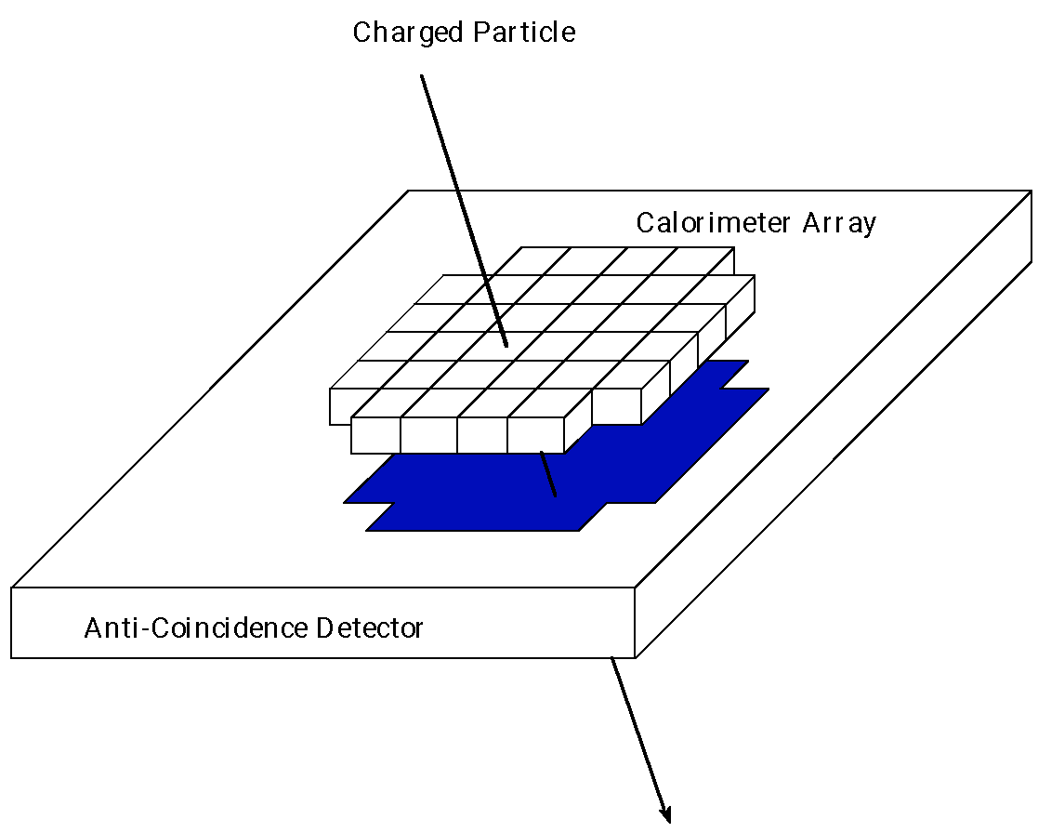
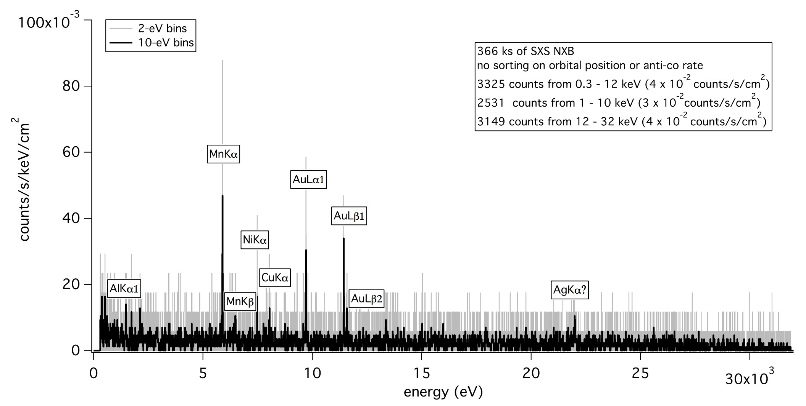
Anti-coincidence Detector
The anti-coincidence detector sits 0.6 mm behind the calorimeter array.
Hitomi/SXS In-flight residual background
< 1 photon/day/10 eV/array
Kilbourne+2018 PASJ

Slide 8
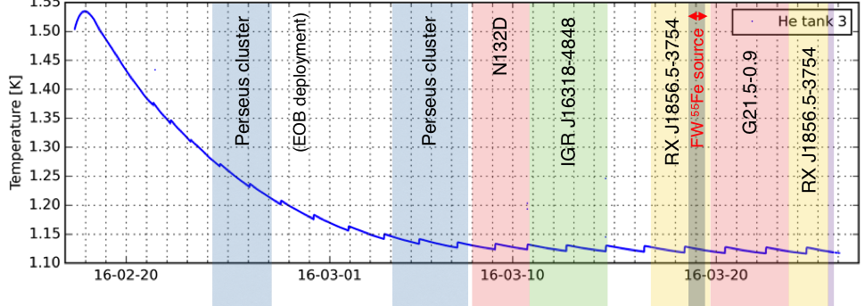
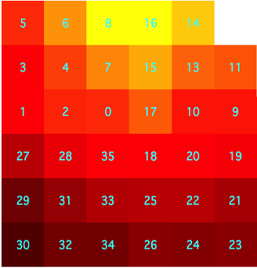
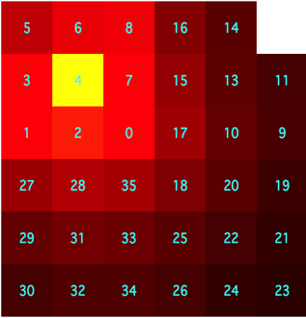
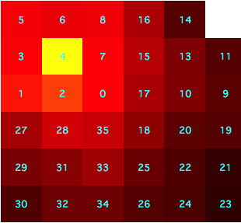
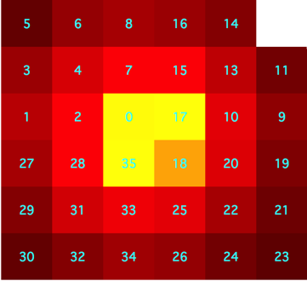
Hitomi Observational Timeline (Feb-Mar 2016)
He tank temperature
Mission lost due to operations mishap after 38 days!

Slide 9
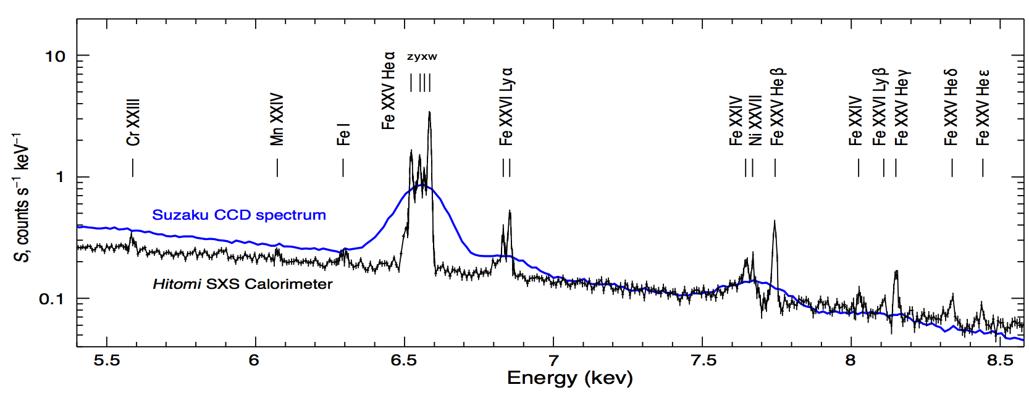
Hitomi SXS spectrum of Perseus cluster
Hitomi Collaboration, Nature 2016
BLACK: Hitomi SXS (FWHM 4.9 eV)
BLUE: Best previous spectrum (Suzaku CCD; FWHM 140 eV)

Slide 10
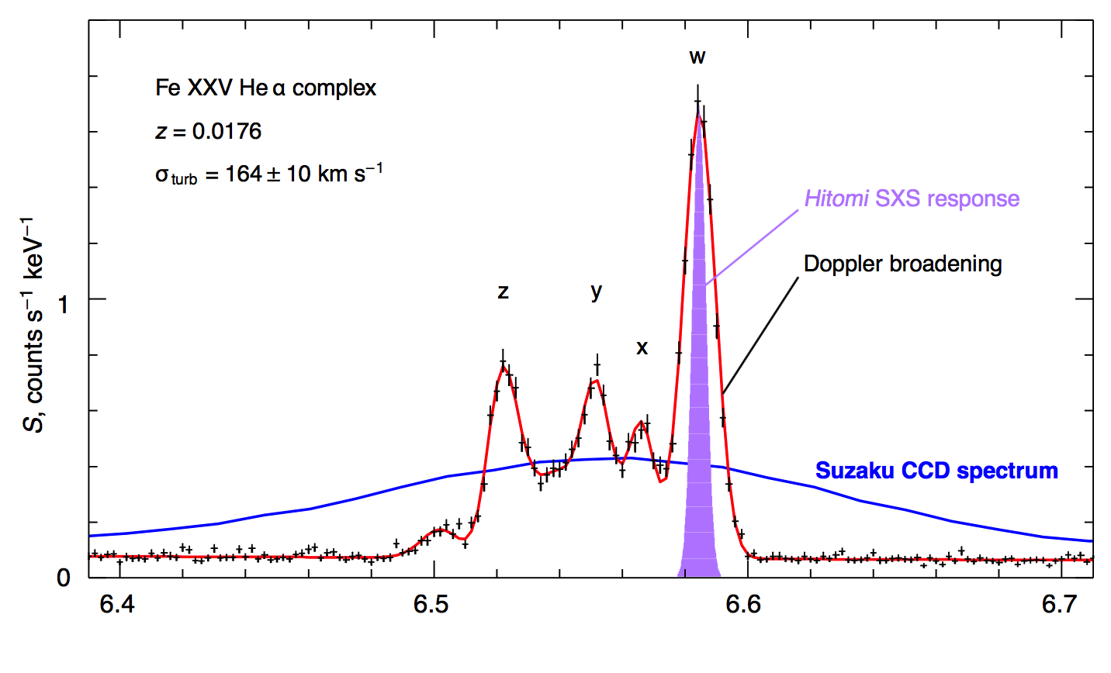
Perseus: Fe XXV (He-like) complex
5 eV energy resolution (FWHM) achieved in orbit, full array
~ 21,000 counts
only 16 due to residual background
Gaussian turbulence
σ_{turb} = 164 ± 12 km s⁻¹
Measured on 10 kpc scale
P_{turb} < 0.04 x P_{thermal}
Energy (keV)
Hitomi Collaboration, Nature 2016

Slide 11
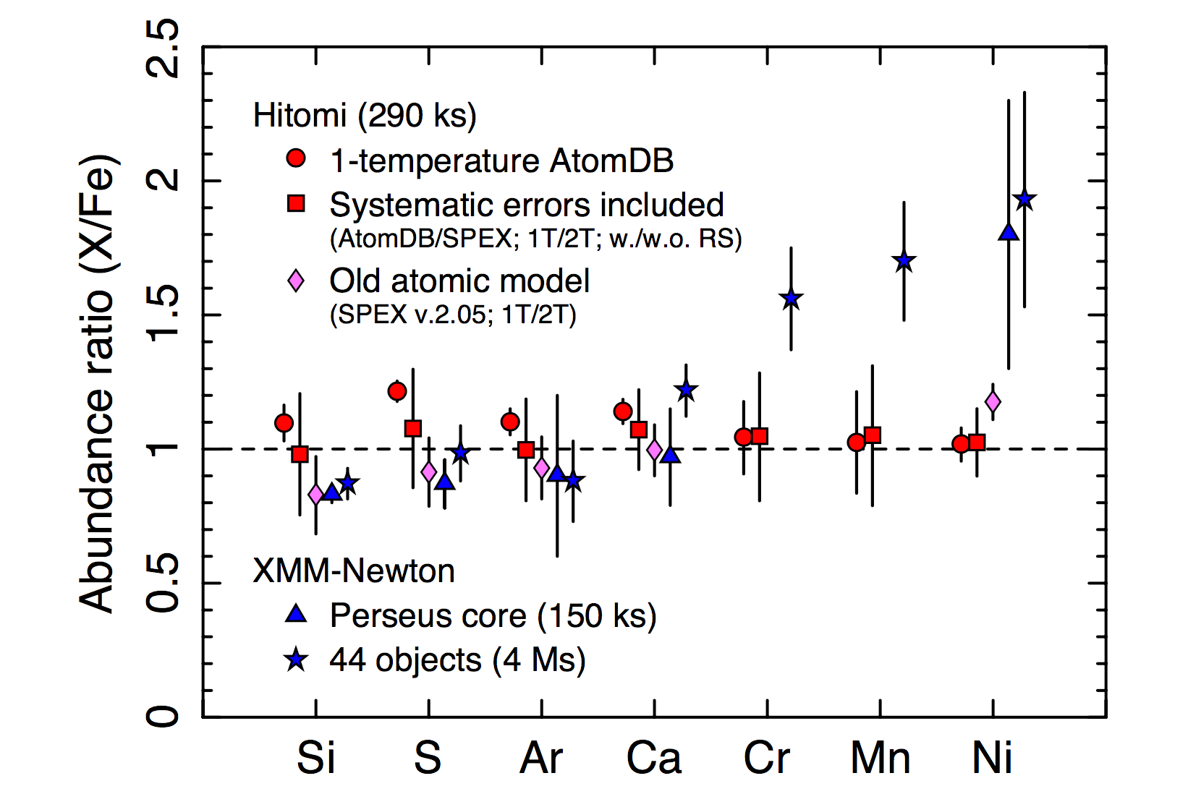
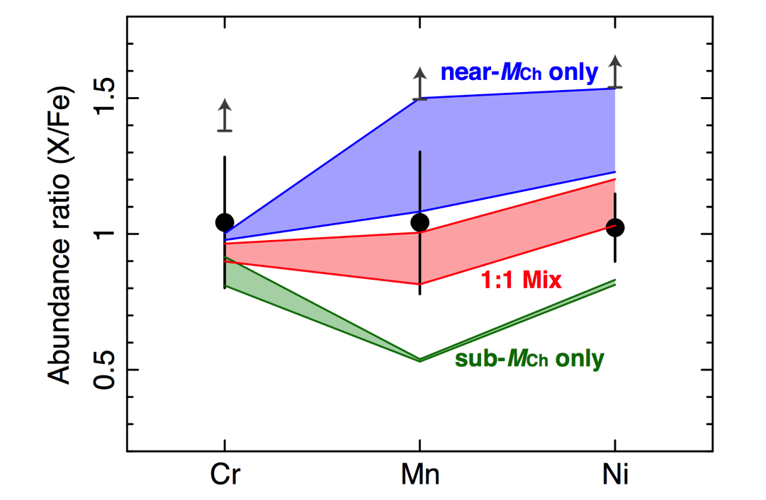
Perseus Cluster
Strong evidence for 2 types of Type Ia SNR’s to produce the elements
Hitomi Collaboration, Nature 2017

Slide 12
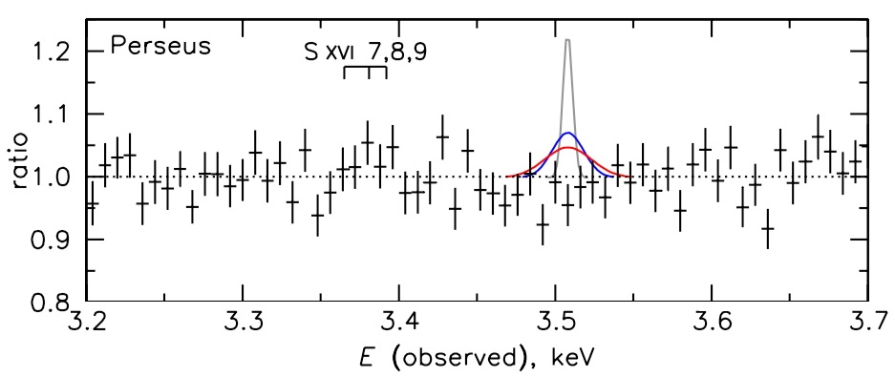
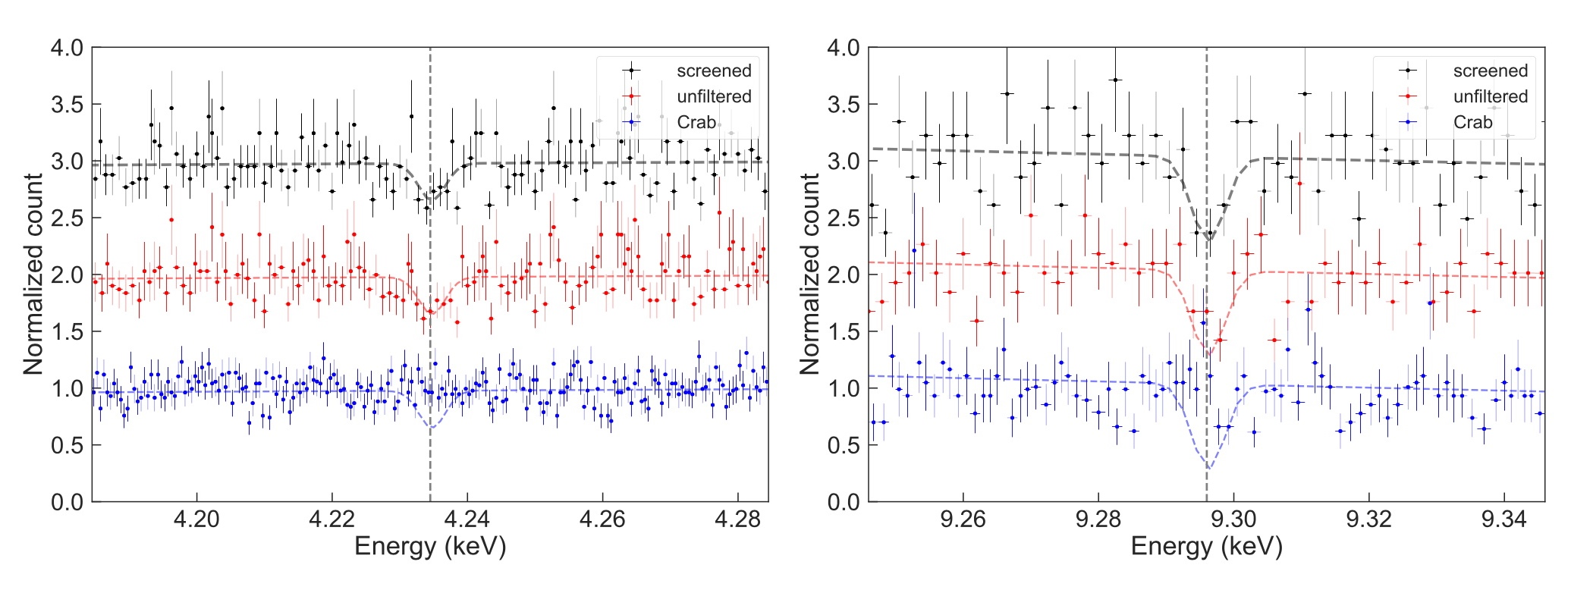
Additional Science Results
Hitomi/SXS provided extremely high spectral resolution in uncharted territory above 2 keV.
Hitomi Collaboration, ApJ Lett. 2017
SXS set very strong upper limit on the existence of a previously purported emission line at 3.5 keV in the Perseus Cluster. Line has been suggested as a possible signature of dark matter.
SXS found strong evidence (3.6 𝜎) for two absorption lines at unexpected energies in the young composite-type supernova remnant (SNR) G21.5−0.9
Hitomi Collaboration, PASJ 2018

Slide 13
High-Level Changes Applied to XRISM
Agency-Agency
Establish Joint Executive Steering Group between NASA and JAXA.
Meets 1-2 times per year or as needed to discuss progress and resolve issues.
NASA Project
Establish project management team at Goddard: project manager, mission-level systems engineering (incl. safety & mission assurance and operations engineering) to provide NASA experience and approaches, share risks, participate in reviews.
Joint Systems Engineering Team with JAXA project.
Monthly telecons, quarterly face-face meetings, participate in project reviews.
JAXA Project
Separate Project Manager and Mission PI. Mission Sys Eng. and JSET. Share risks at mission level.
Creation of detailed plan for JAXA to oversee contractors.
Mission operations responsibility moved from contractor to JAXA.
External science advisory panel.
Project start in 2017

Slide 14
Technical Changes Applied to XRISM
Addition of Heater Control Electronics (HCE) and additional channels in the Non-Explosive Actuator (NEA) Controller for the Resolve Vibration Isolation System (VIS) locking system.
Changes in the AOCS include replacing the Coarse Sun Sensors (CSS) with Digital Sun Sensors that have a wider field of view than the CSSs.
Replacing the two NEC star trackers with three Sodern SED26 Star Trackers.
Updates to the AOCS software for the new components, updates to the Kalman filter so that it will accept star tracker data updates if it is rejected too long, spacecraft spin rate used for safety checks.
Changes to the Fault Detection Isolation and Recovery software.
The power system changes include new solar cells (SHARP 502A to SolAero ZTJ cells) and new battery cells that bring the batteries from 100 AH to 110 AH.
NASA providing support for additional ground coverage during critical phase of mission.
Verified instrument performance with aperture door open; no sensitivity to radio frequencies.

Slide 15
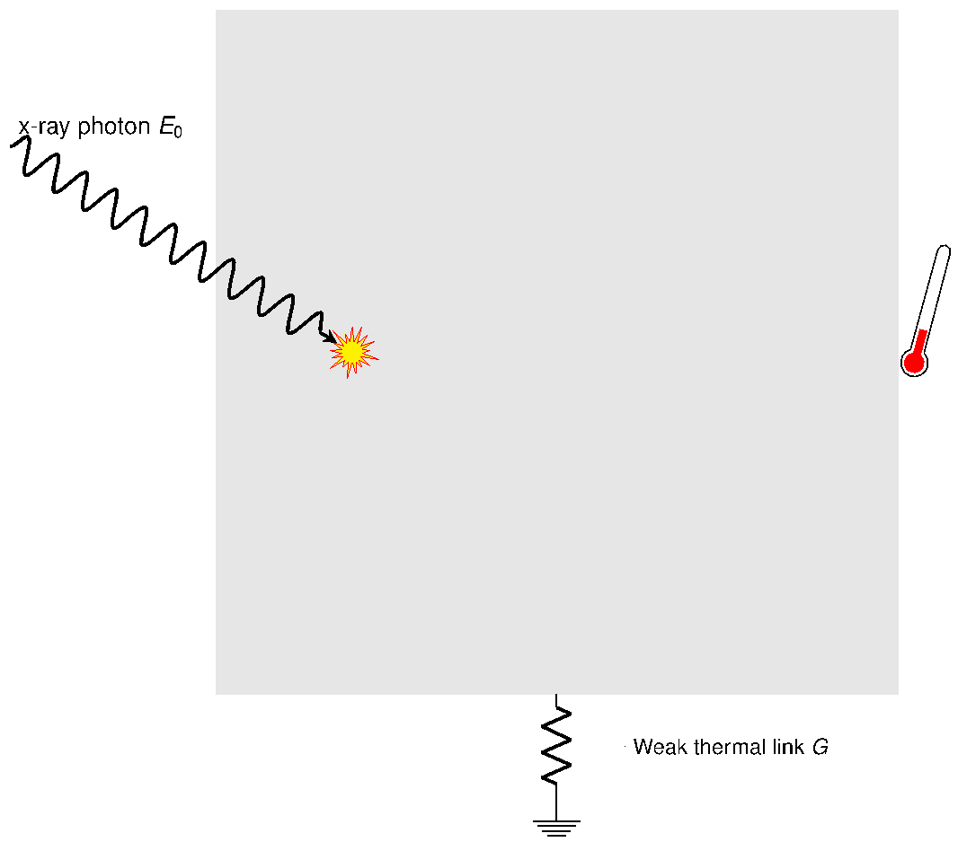
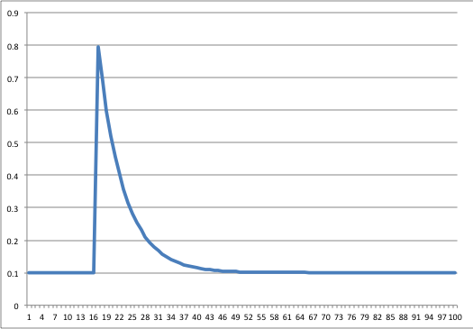
Single Photon (“quantum”) Calorimeter
Particle or photon
Heat capacity, C
Thermal time constant
Thermal link, G
T_{b}
E_{x}/C
τ
Requires ultra-low temperature: < 0.1K
T_{b}

Slide 16
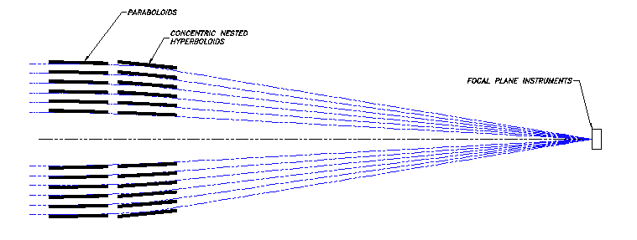
Major Components of X-ray Calorimeter Spectrometer
Primary
Secondary
X-ray Calorimeter Spectrometer
X-ray Telescope
Point Source on Array
A_{eff}(E) = A_{XRT}(E) * t(E) * psf * f_{array} * a(E)
t = transmission of blocking filters
psf = x-ray image point spread function
f_{array} = geometric filling factor of array
a = absorption efficiency of detector

Slide 17
XRISM/Resolve Array
3x3’ FOV – 30” pixels

Slide 18
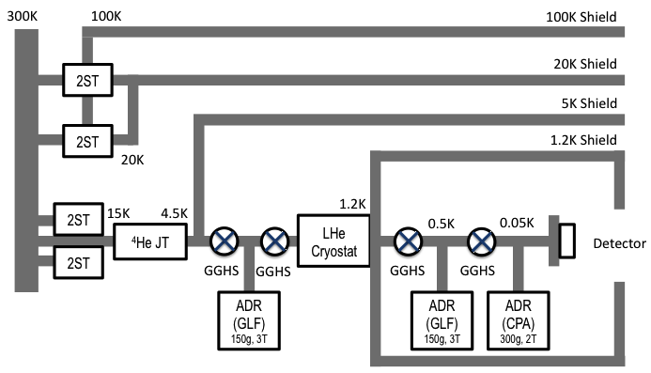
Cooling System
JT shield
Notes:
Include design details, resource impacts (cost, schedule, staffing, etc.), and performance/functional requirements impacts.
ISAS/JAXA presentations do not need to show cost, schedule, staffing impacts of design changes.

Slide 19
Resolve Dewar design

Slide 20
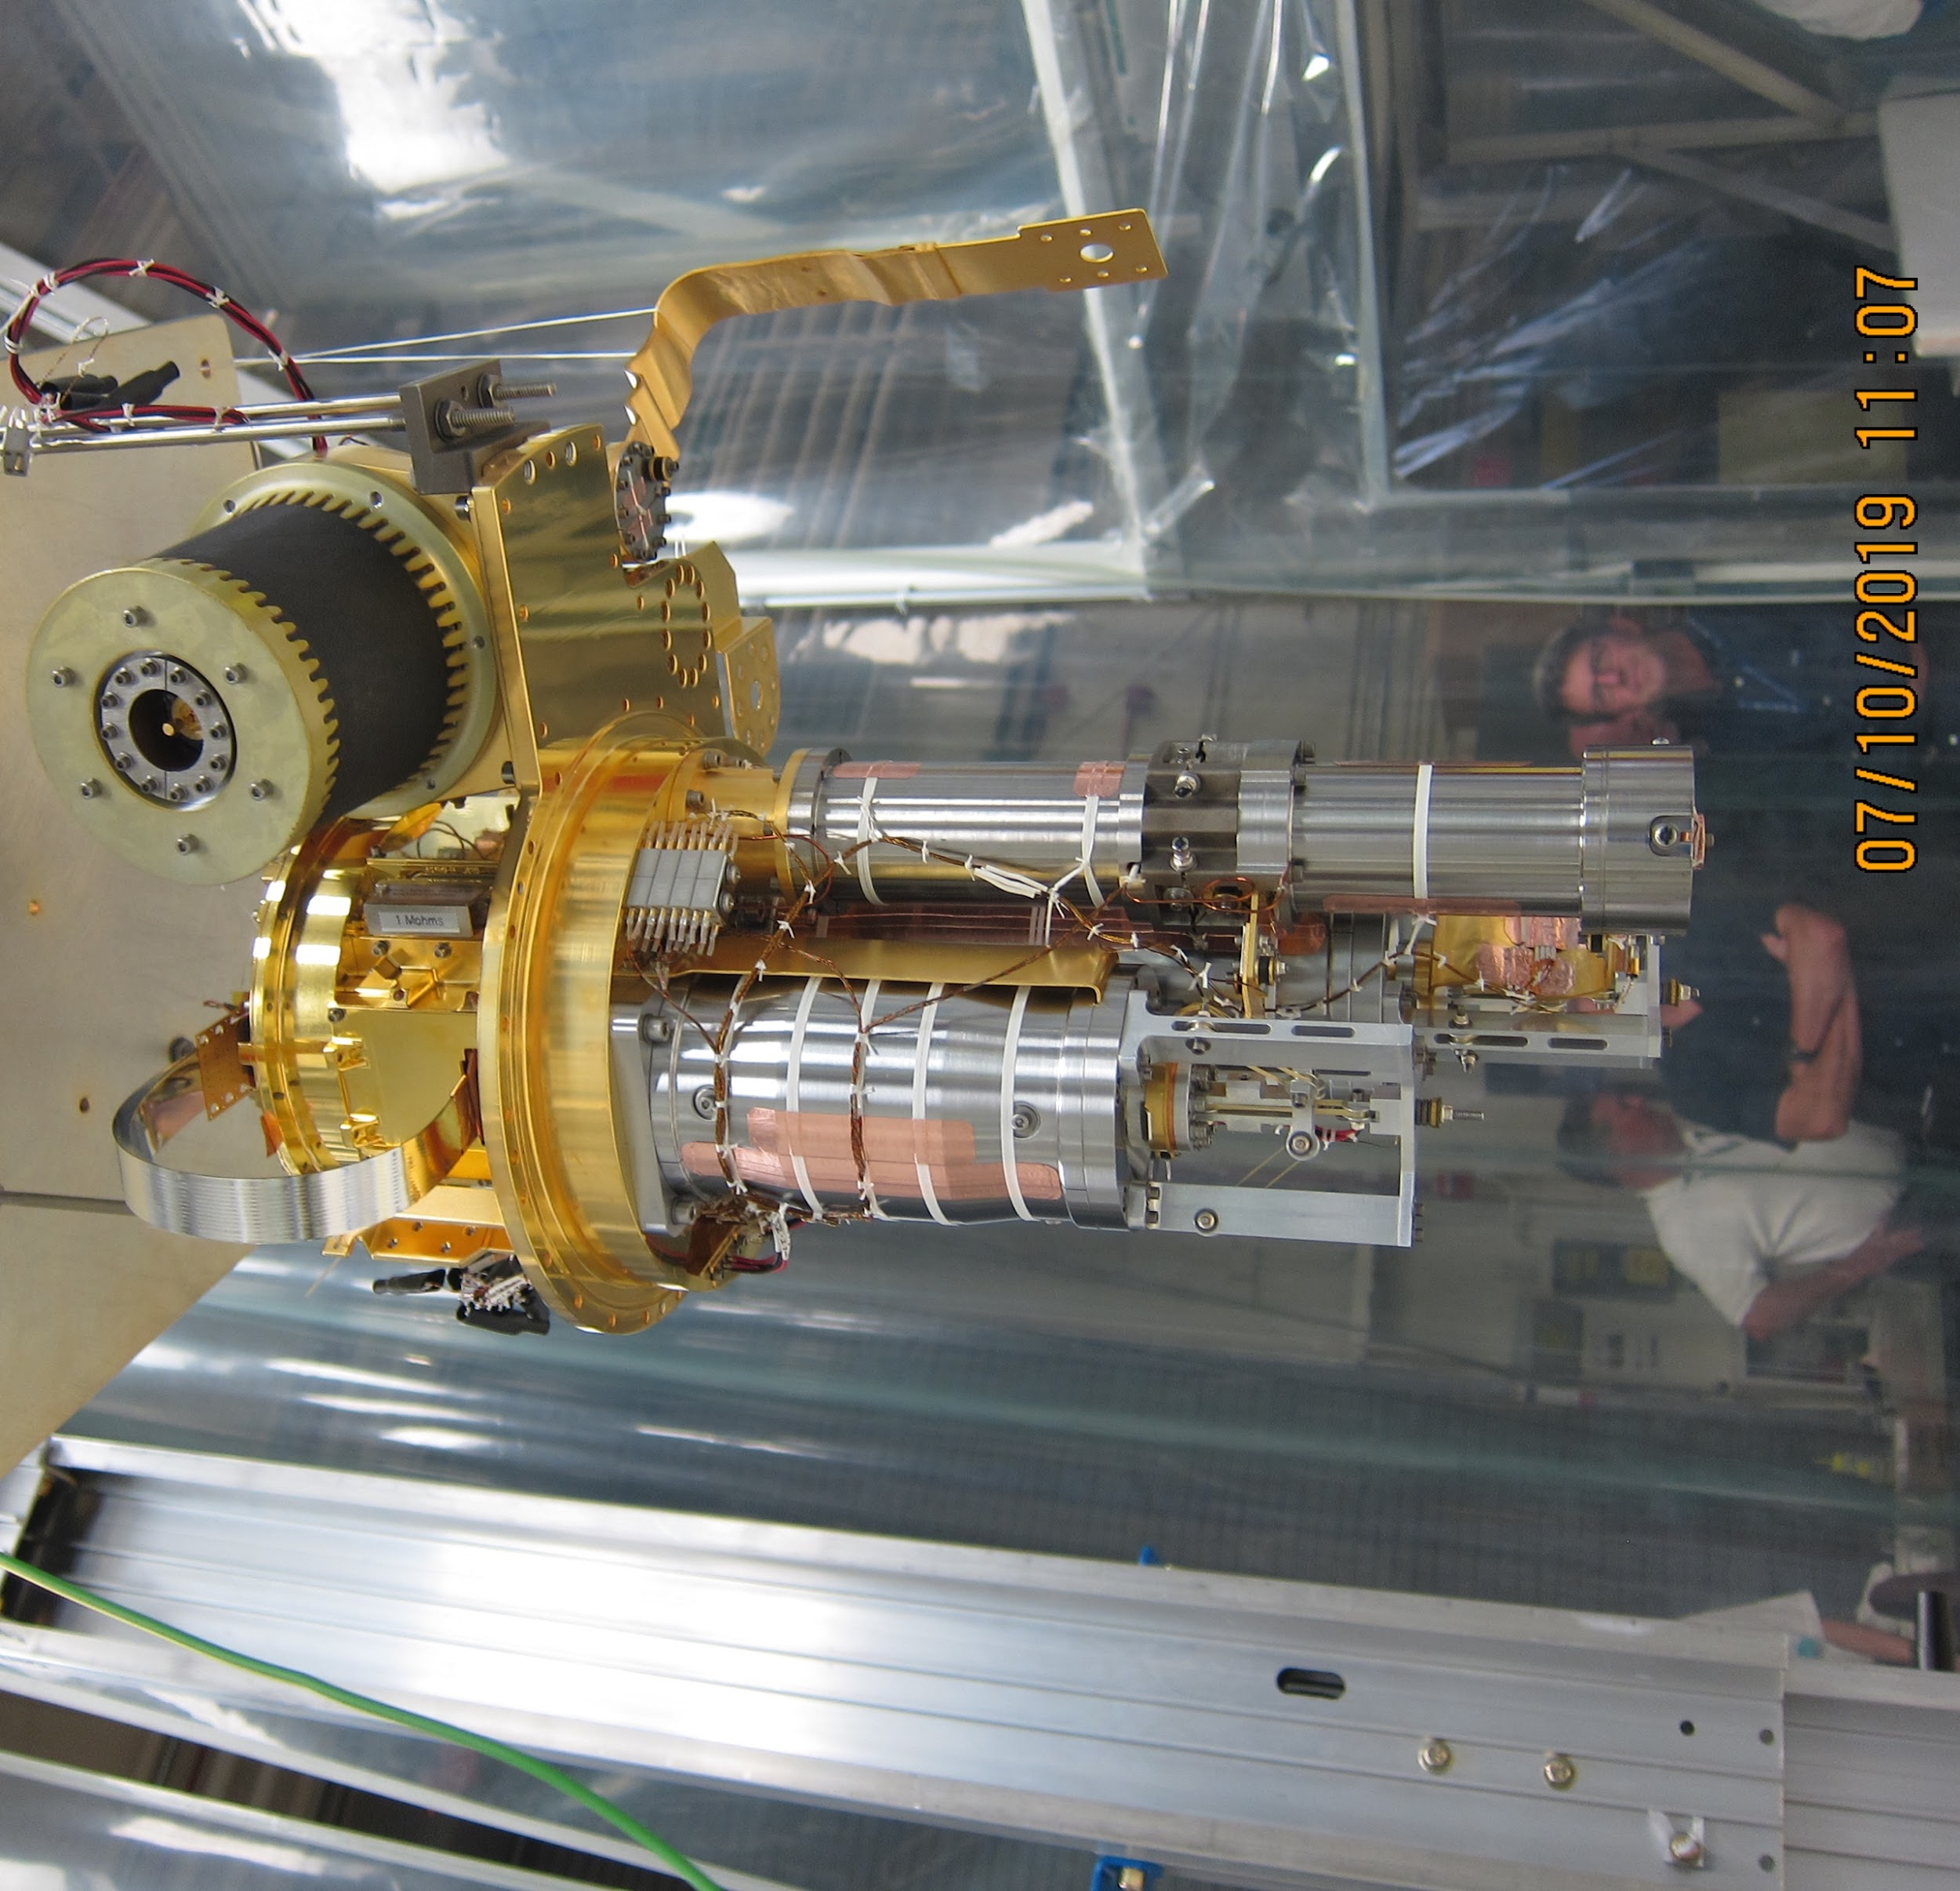
Resolve Detector Assembly and 3-stage ADR

Slide 21
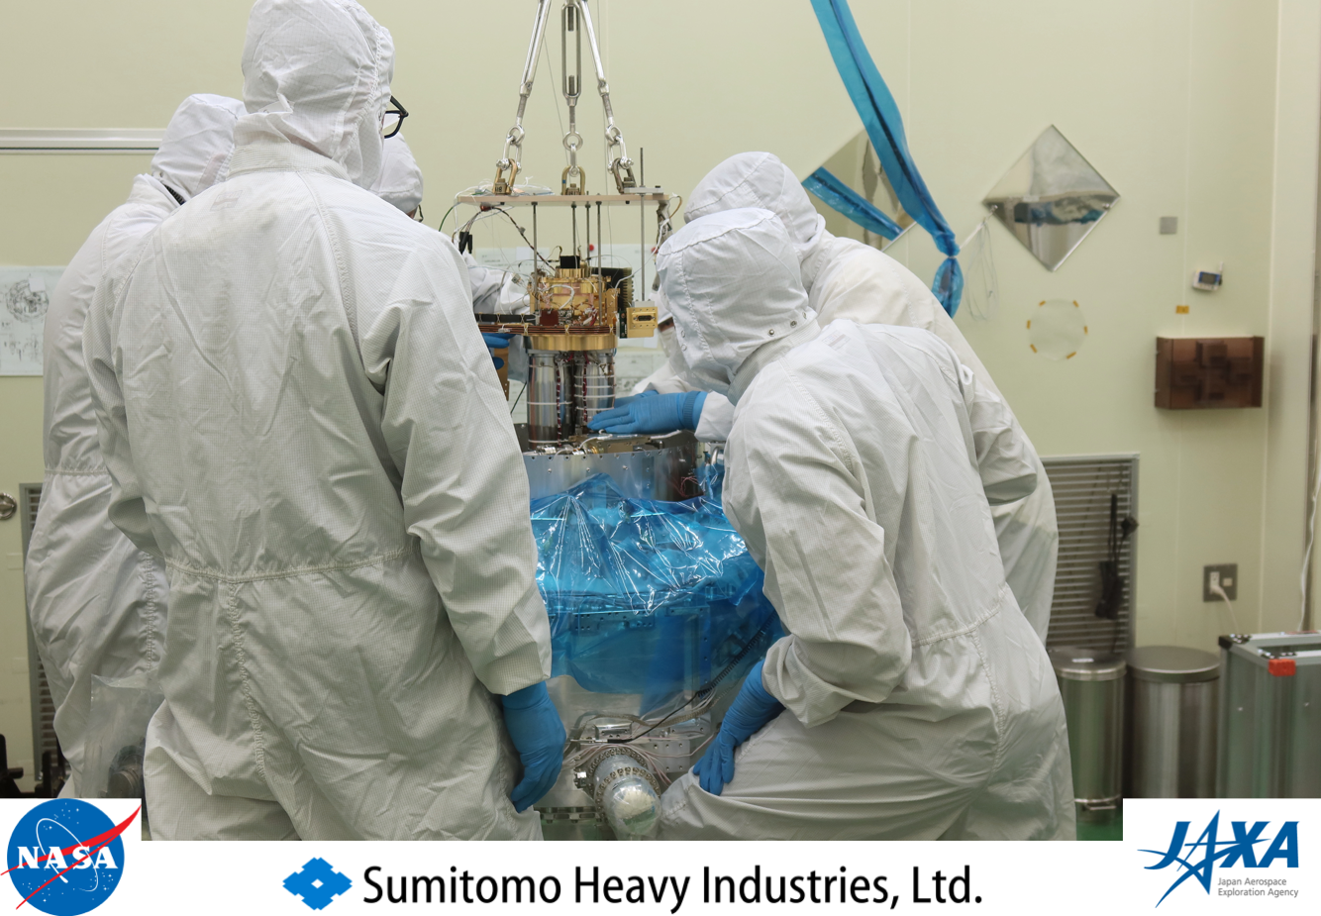
Integration with Dewar

Slide 22
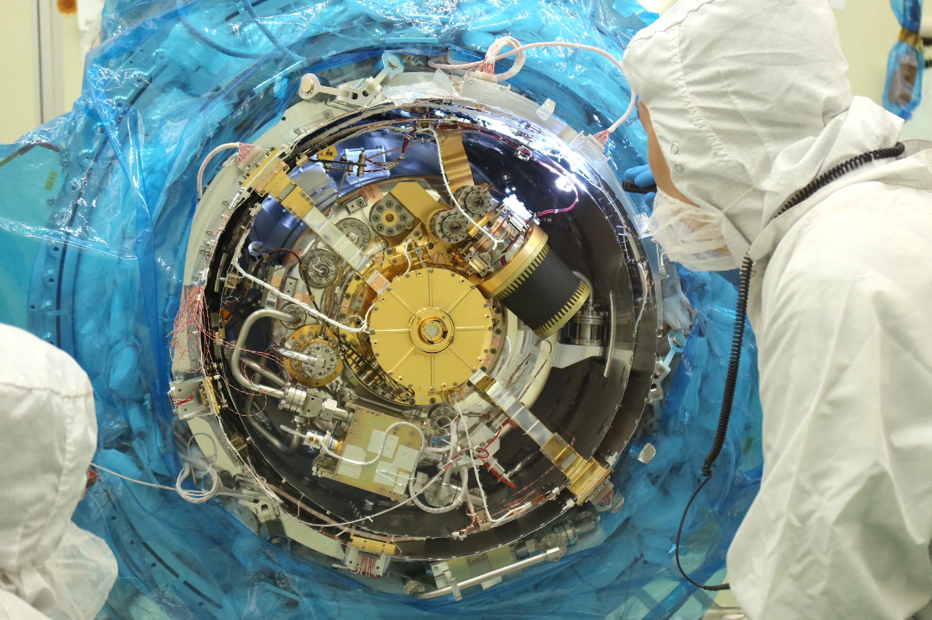
Resolve Dewar during Assembly

Slide 23
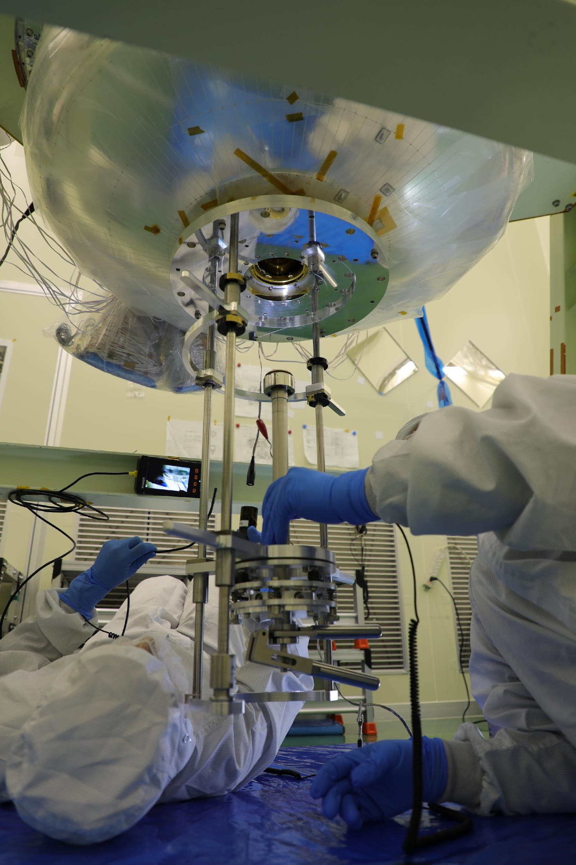
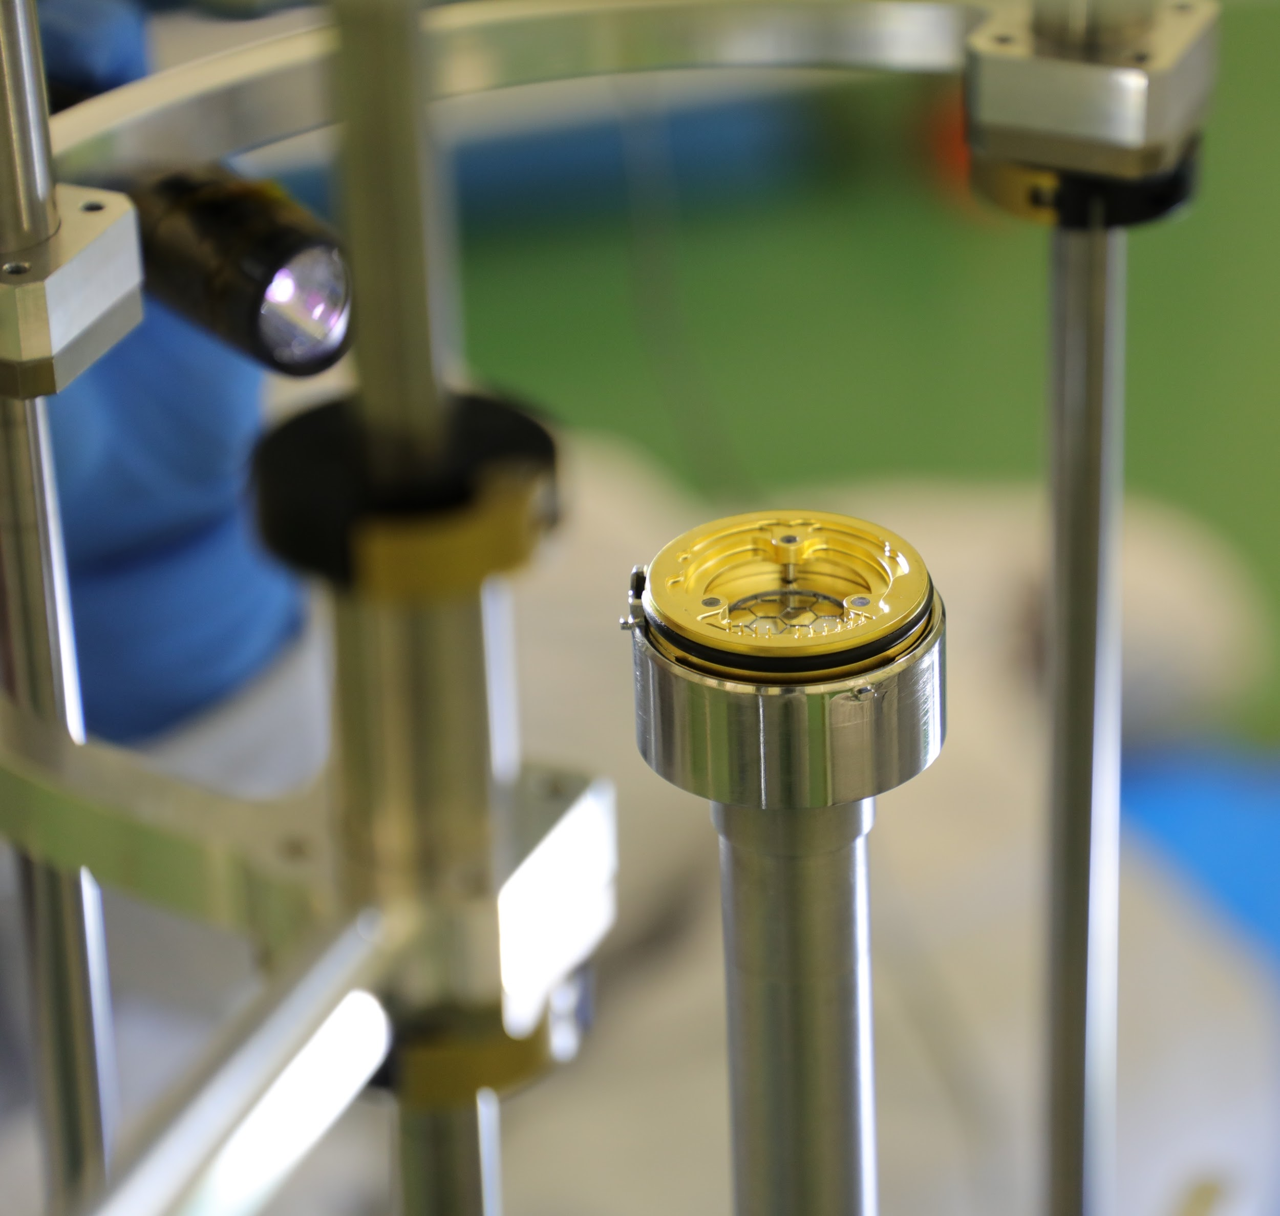
Blocking Filters
There are 5 separate thin-film thermal blocking filters in the dewar. The outer three have defrost heaters.

Slide 24
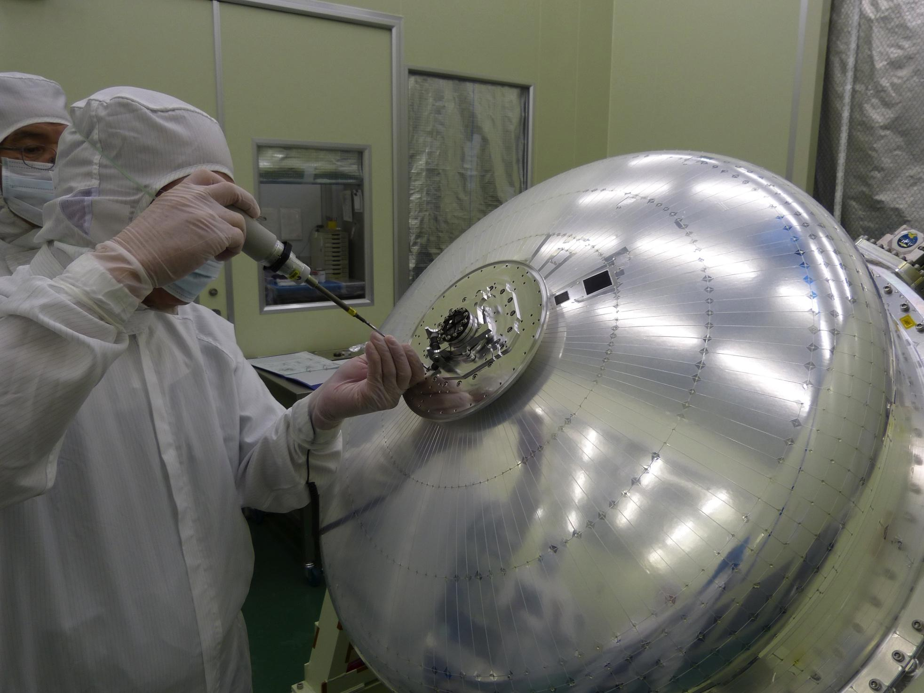
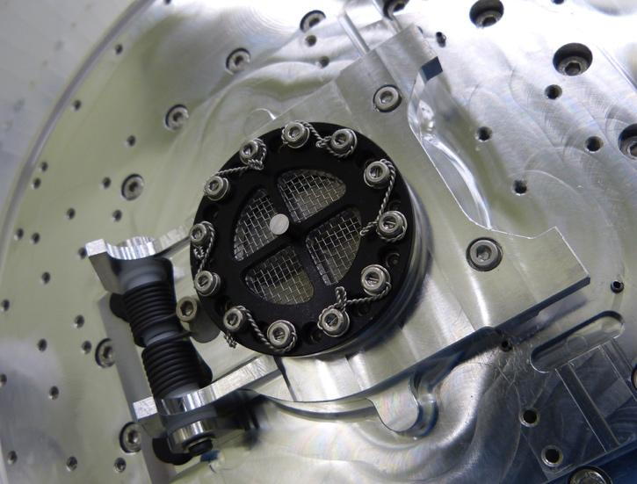
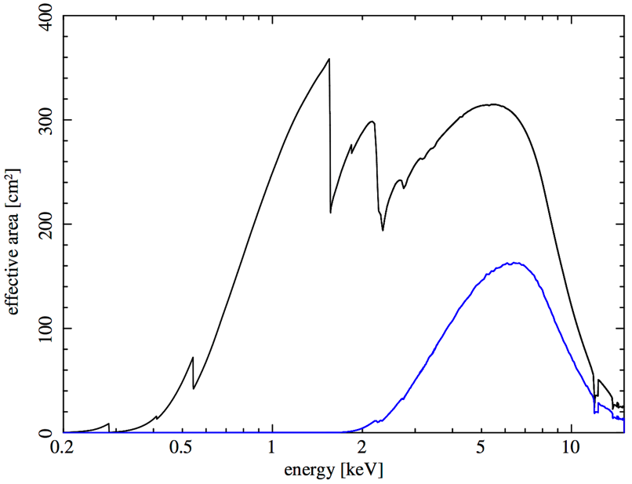
SXS Dewar Aperture Door Installation
270 μm Be window+screen
Door open
Door closed

Slide 25
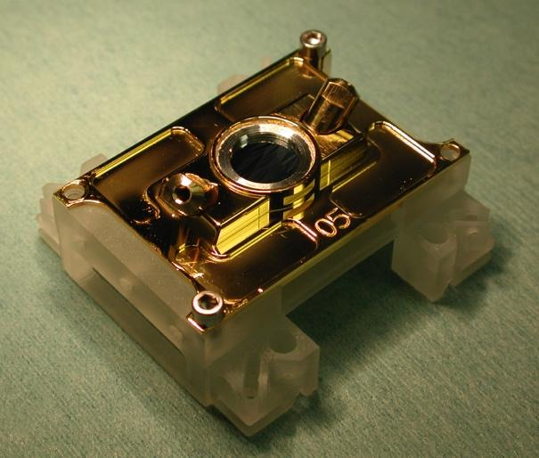
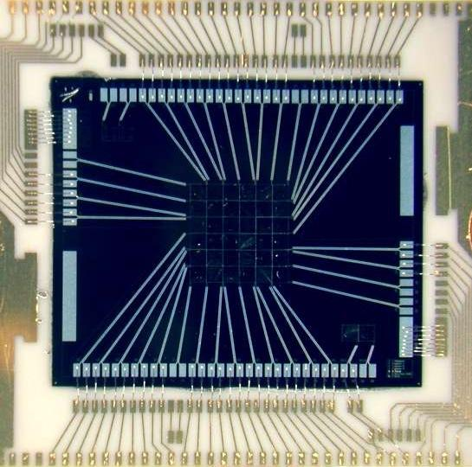
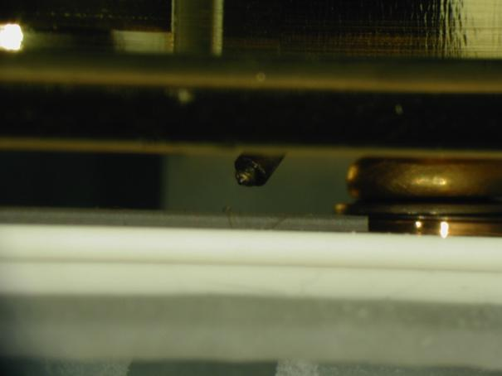
Gain Tracking – internal cal source (6 keV)
Dedicated calibration pixel to characterize gain drift of full array
Calibration
pixel
XRS flight array
⁵⁵Fe source
Test box with actual detector board mockup.

Slide 26
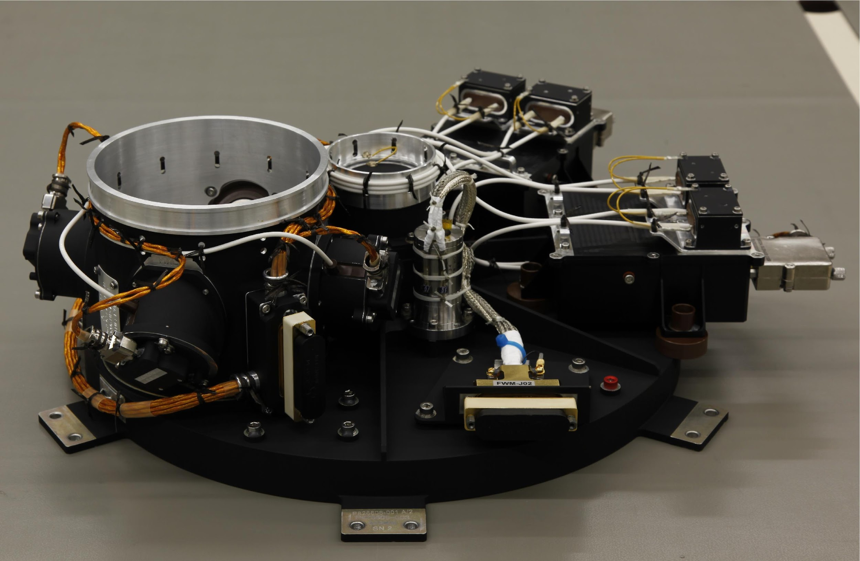
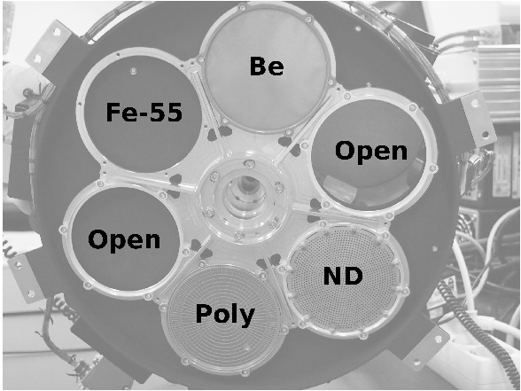
Filter Wheel and Modulated X-Ray Sources
The filter wheel
Neutral filter: made of a layer (0.25 mm) of molybdenum (Mo) with holes (1mm). Suppresses flux for bright objects
Be filter (25 μm) suppresses the soft X-ray of incoming flux.
Polyimide filter (200 nm) and 2 layers of Al (65 nm), in a sandwich configuration.
Blocks optical/UV light
⁵⁵Fe: produces ⁵⁵Mn lines K α and K β at E=5.895 and 6.490 keV
Pixel by pixel calibration

Slide 27
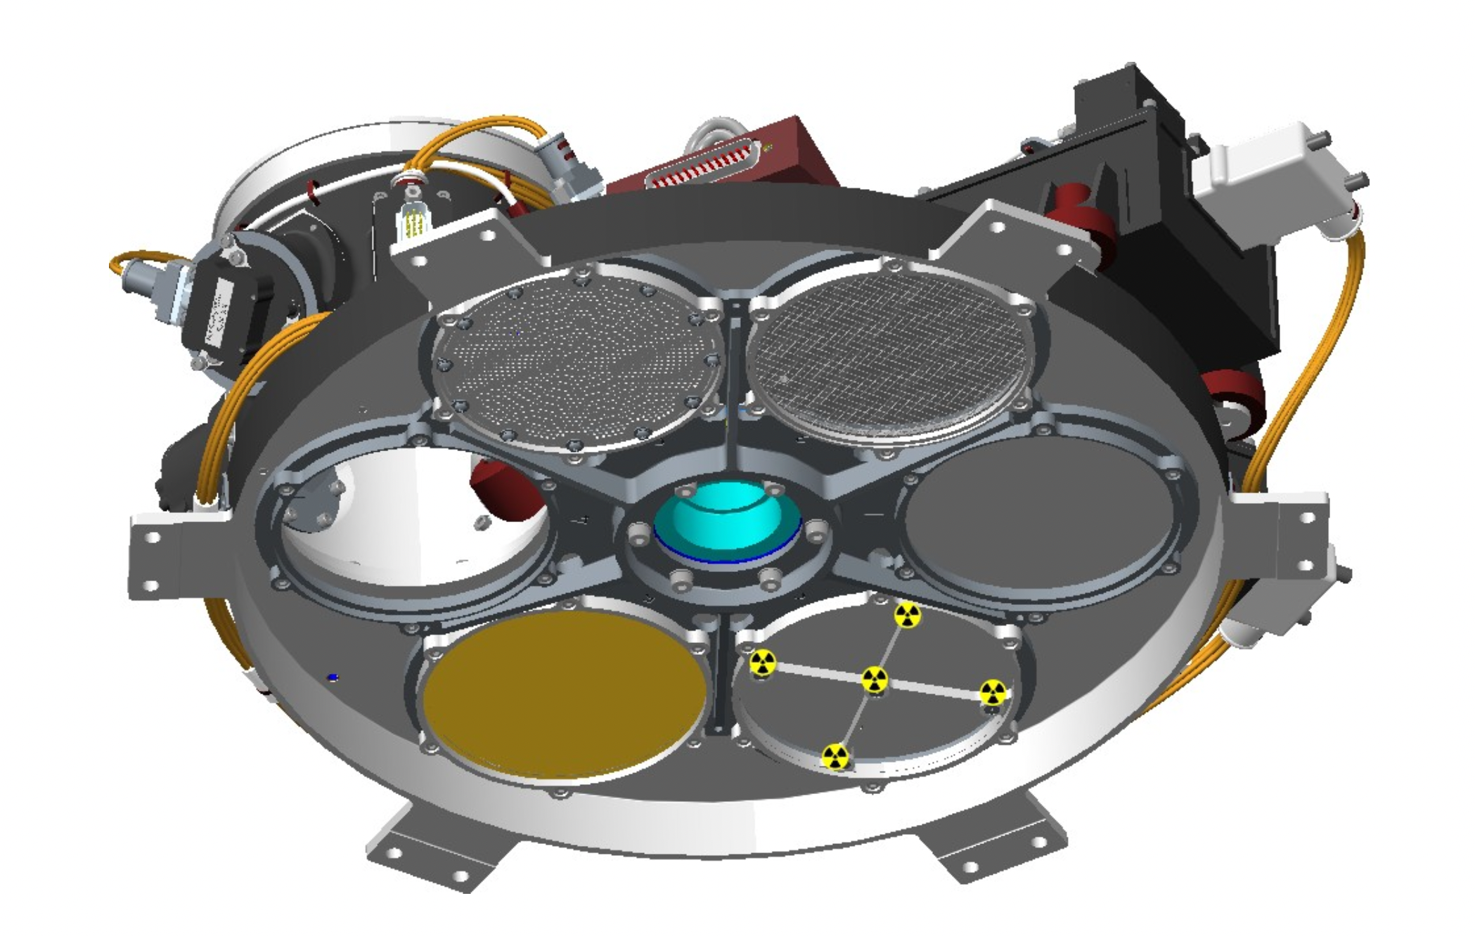
Filter Wheel

Slide 28
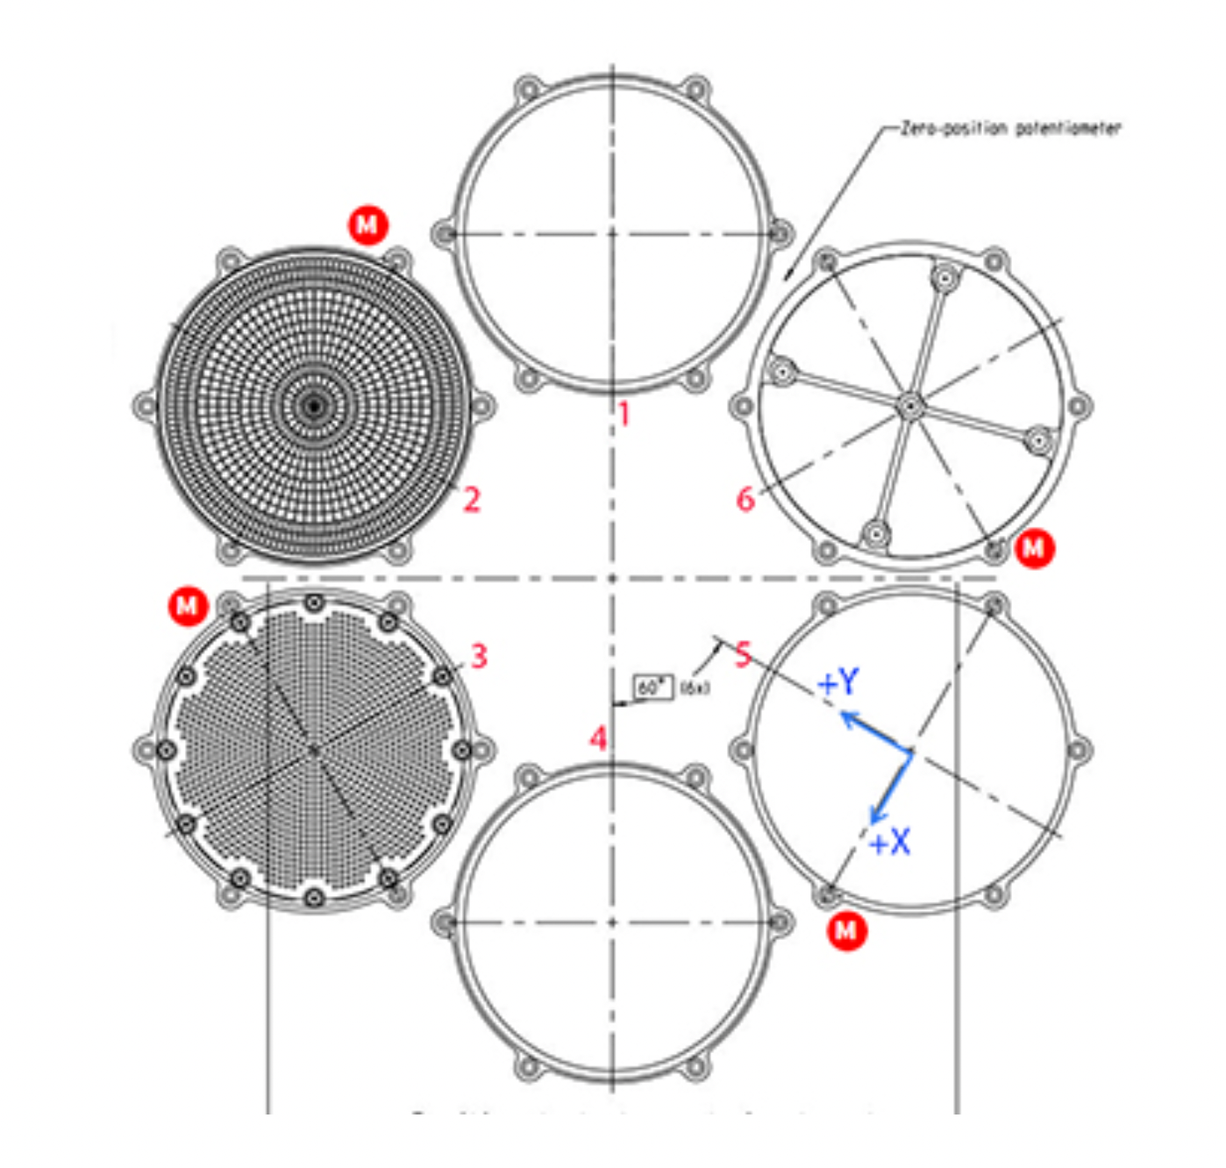
Filter Wheel Filters
Open
Polyimide
Open/⁵⁵Fe
ND
Be
(25 um)
Open

Slide 29
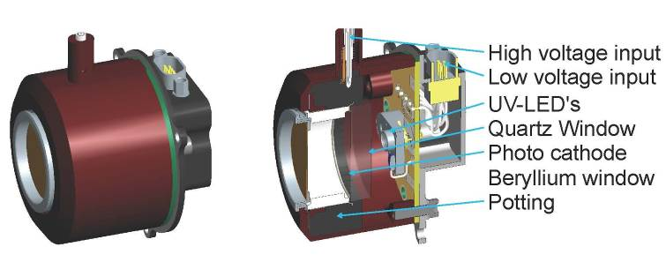
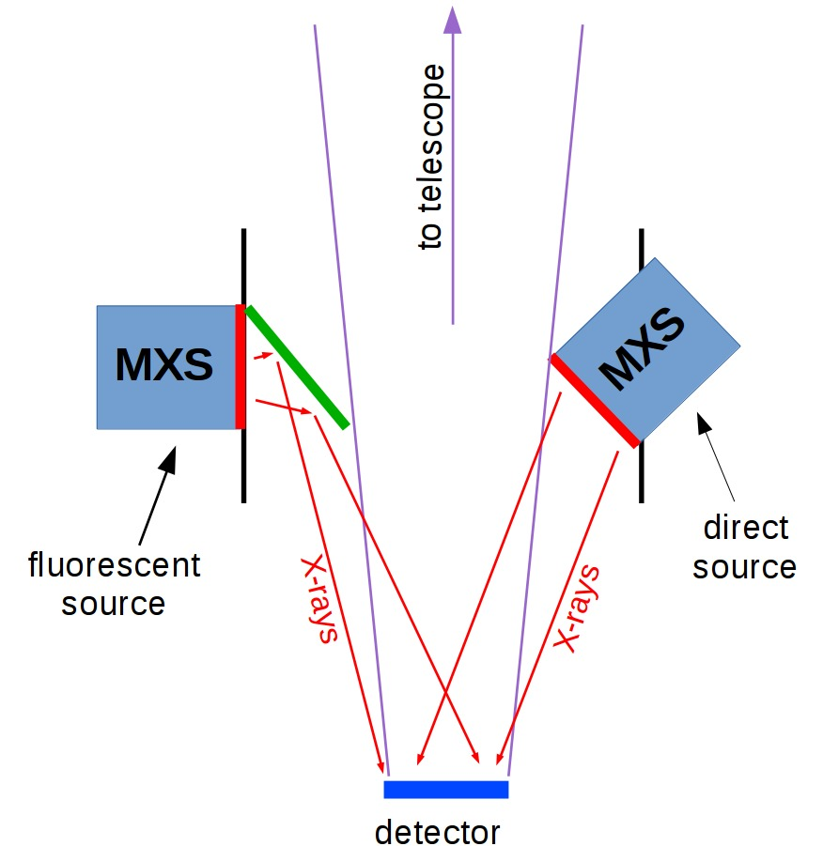
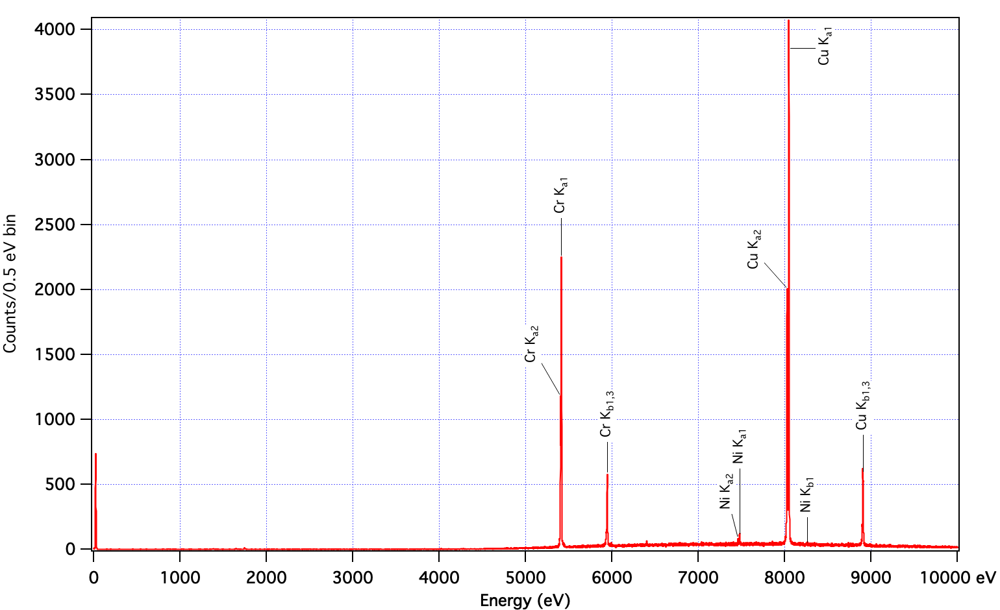
The Modulated X-ray Sources (MXS)
Resolve Spectrum

Slide 30
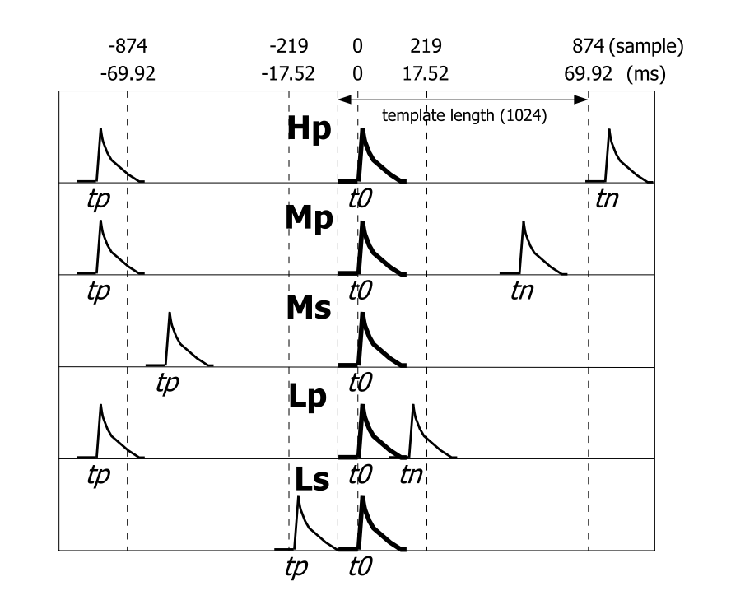
Event Grades
Pulse height determined with optimal filter using 1024 points
template length (256)
Pulse height determined with optimal filter using 256 points (truncated from high-res)
Pulse height determined using peak of pulse derivative
τ₂
τ₁
τ₂
Seta+ 2012 (IEEE)

Slide 31
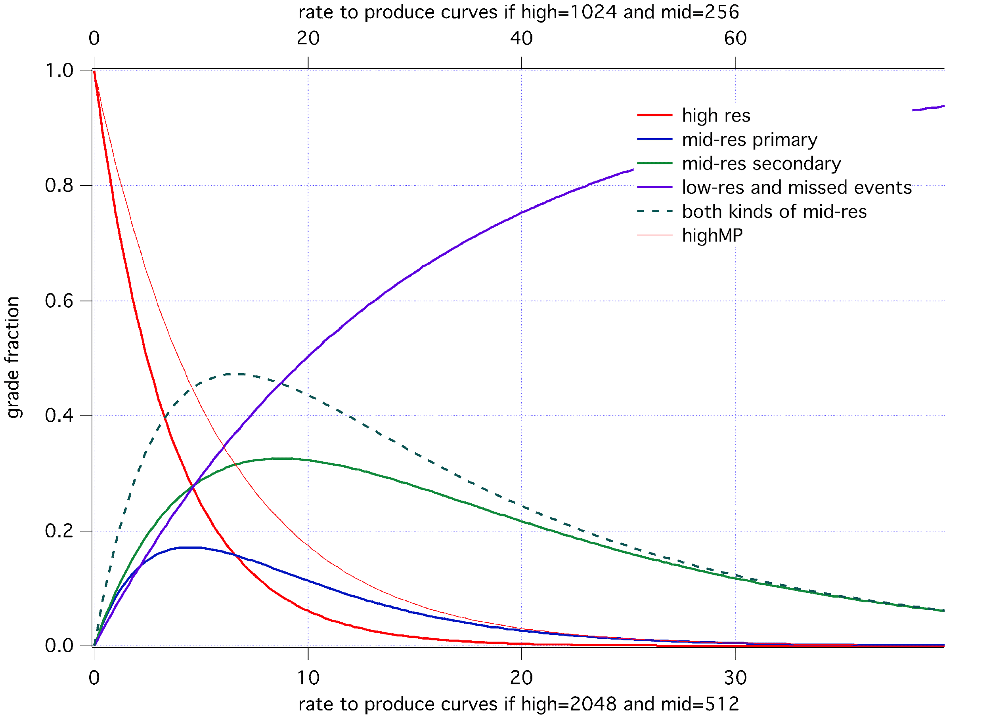
Event Grade Fractions

Slide 32
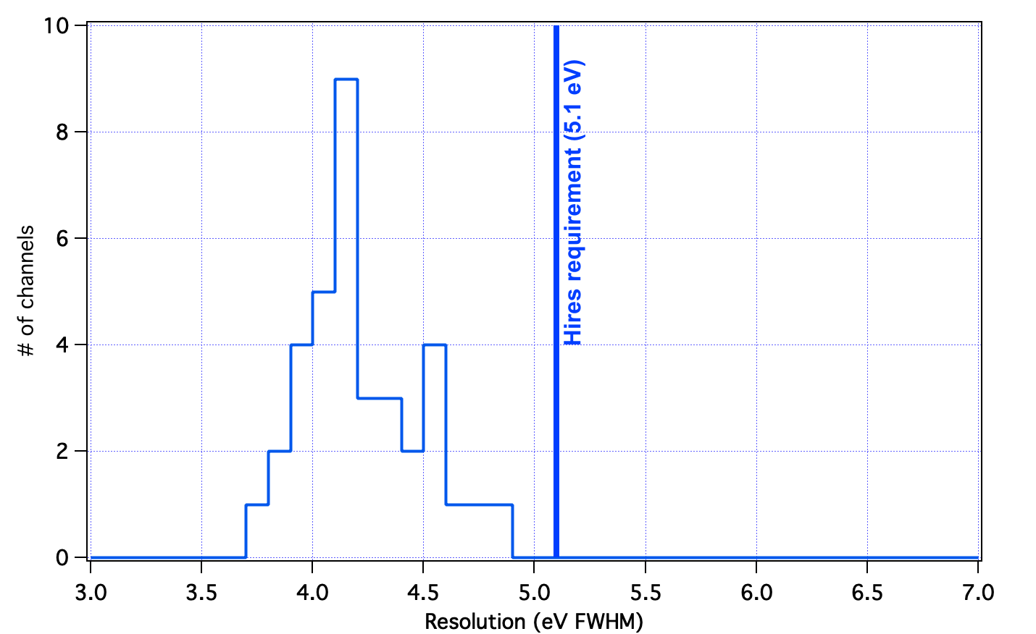
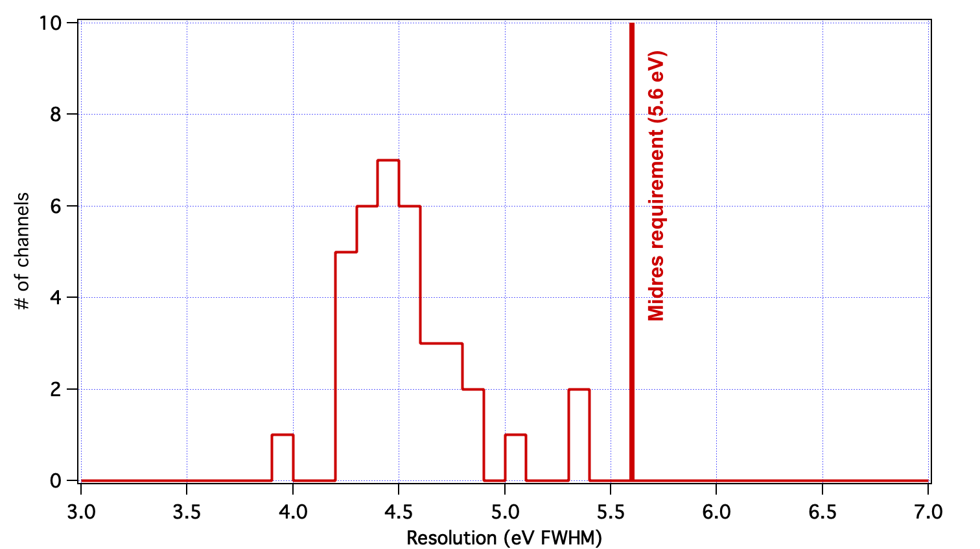
Energy Resolution per pixel
All pixels meet requirements at the instrument level of assembly
Hi-Res
Mid-Res
Midres

Slide 33
Simulation of celestial point source
20 cps into array
Cal pixel
Rate is ~ 5 cps
Actual location of cal pixel is outside of the field of view.

Slide 34
Induced cross-talk on array. Readout topology results in most cross-talk being in outer pixels, where there are fewer celestial counts. Nice feature!

Slide 35
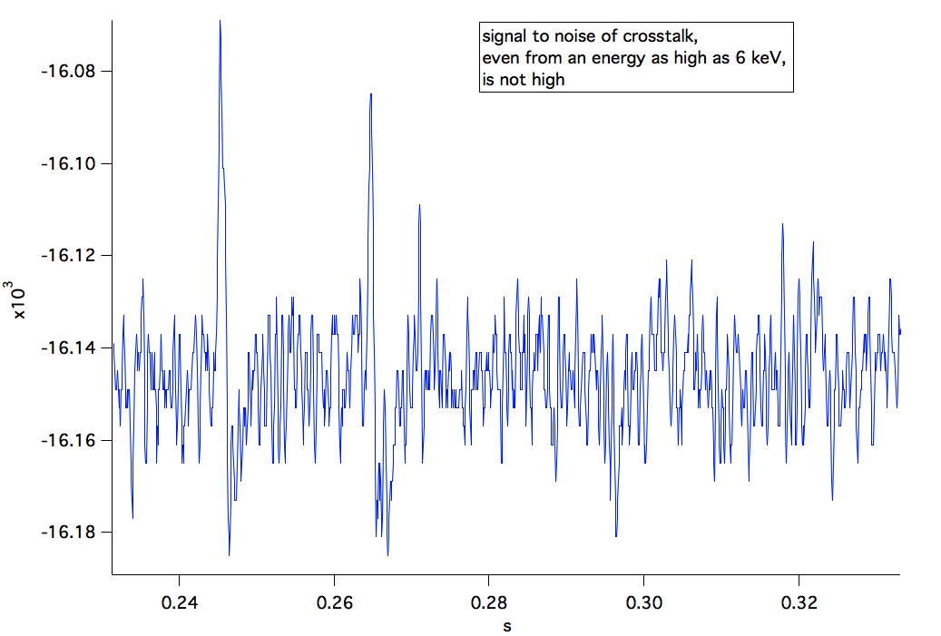
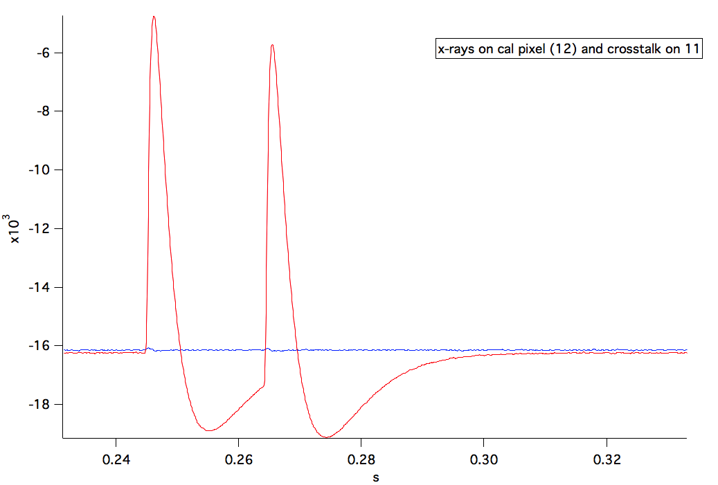
Crosstalk

Slide 36
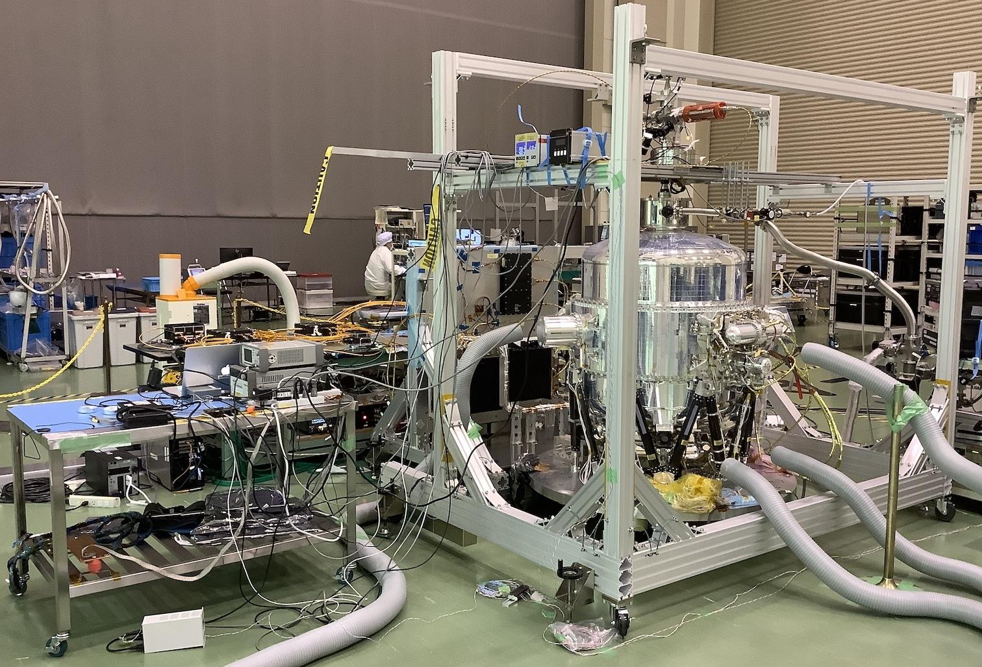
Resolve at the Tsukuba Space Center, Japan
March 2022

Slide 37
Resolve Calibration
Key performance characteristics that must be measured/calibrated
Energy resolution of full array
Line spread function
Spectral redistribution
Energy scale determination under different conditions
Event grade assignment
Crosstalk
Residual background

Slide 38
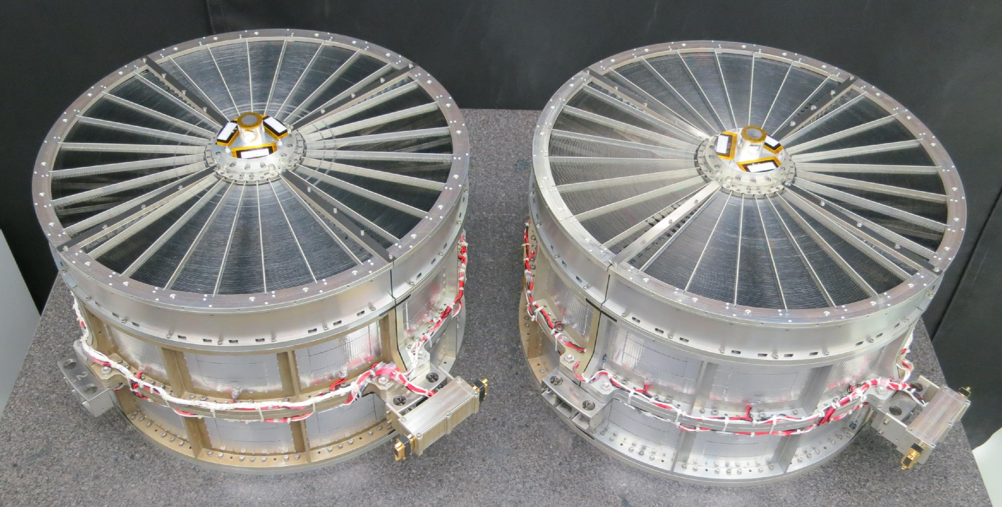
XRISM X-Ray Mirror Assemblies
Xtend
Resolve
2/22/23
(thermal shield not installed)
(Document Name Here)
Use or disclosure of data contained on this page is subject to the restriction(s) on the title page of this document.
‹#›

Slide 39
XRISM X-Ray Mirror Assemblies
Xtend
Resolve
With thermal shields attached

Slide 40
Anticipated Overall Effective Area Curve
Astro-H
XRISM plot in progress

Slide 41
XRISM X-Ray Mirror Assemblies - Calibration
Key performance characteristics that must be calibrated
Point spread function (PSF) – Half-Power Diameter and FWHM
Effective area
Off-axis response
Vignetting

Slide 42
Data Distribution
JAXA is responsible for the creation of First Fits Files
These are made available to the NASA Science Data Center (Goddard Space Flight Center) and they run pipeline software to produce calibrated FITS files for data analysis.
These files will be available to scientists observing under their respective space agencies (JAXA, NASA, ESA).

Slide 43
Status
Spacecraft is close to complete
Review process next month for readiness to ship to Tanegashima
XRISM will nominally ship in March
Launch planned for May. Dual manifest with SLIM, so a pinpoint launch time each day for a couple of weeks.
Instrument performance has been thoroughly investigated and verified.
Instrument calibration measurements complete; calibration data base products are largely complete but there are data base items still in work.
Pipeline software making good progress – Build 6 will be released soon.
Almost there!

Slide 44
Conclusion
The XRISM mission is at hand – instruments are complete, spacecraft components have all been delivered and tested.
Time to get ready to use it!
Thanks to a huge team in Japan, US and Europe working tirelessly, and through the pandemic, for 7 years to get us to this point!

